Slide 1
Unit 5 Animals

Slide 2
What animals can you see in the pictures?

Slide 3
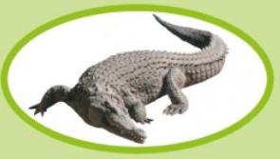
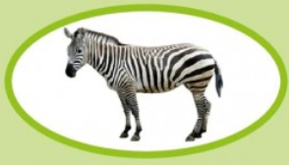
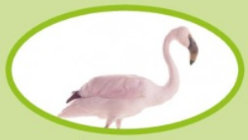
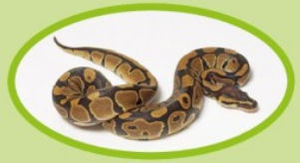
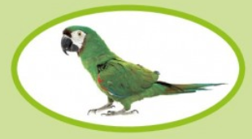
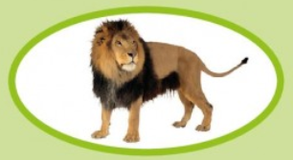
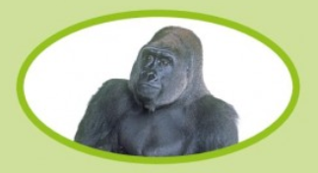
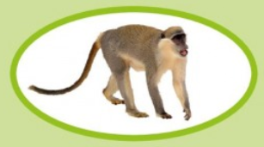

Slide 4
Words
crocodile
zebra
parrot
flamingo
lion
python
monkey
gorilla

Slide 5
head
legs
body
wings
tail
nose

Slide 6
tail
arm
feathers
hair
whiskers
claws
teeth
scales

Slide 7
mammal
backbone
egg
lay eggs

Slide 8
AB 47

