Slide 1
Even more Liz Climo

Slide 7
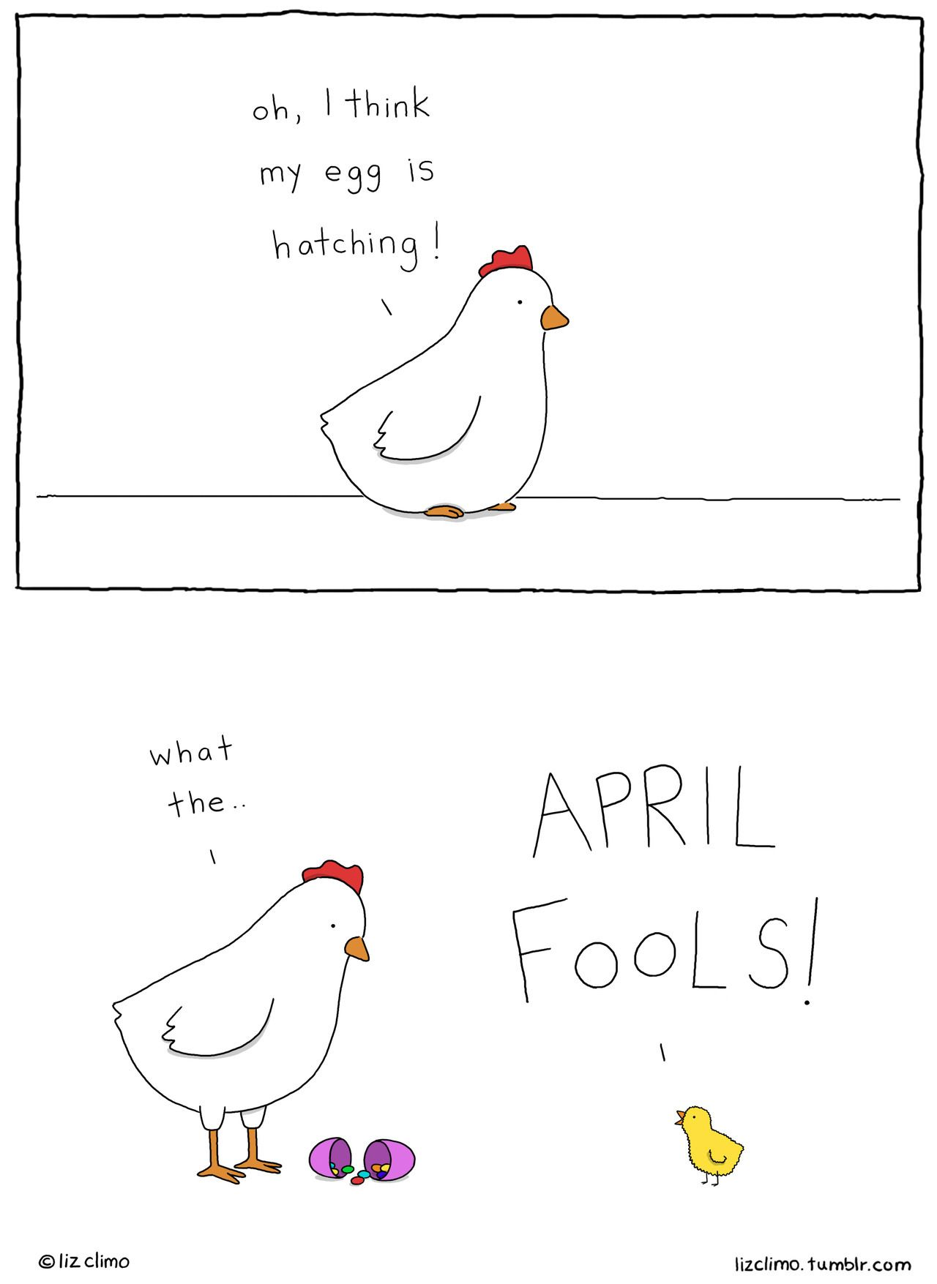

Slide 8
