Slide 1
Liz Climo

Slide 6
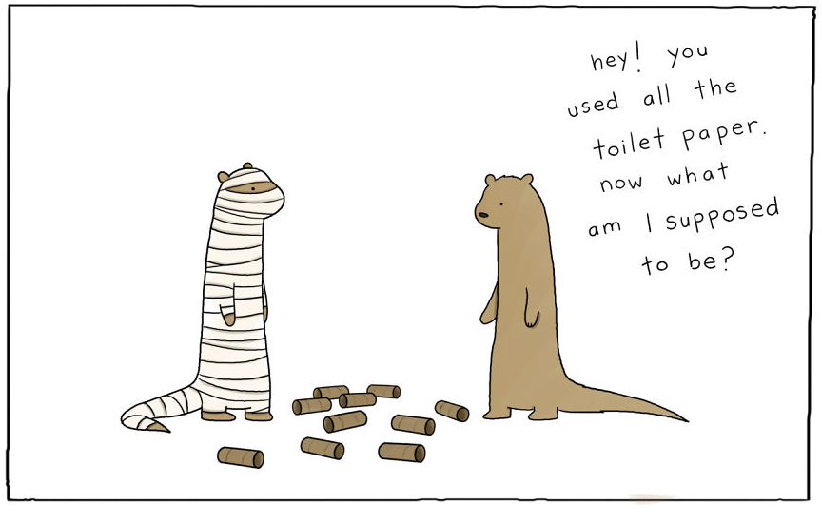

Slide 7
